Slide 1
Module 5: Analyze Dynamics 365 Sales data

Slide 2
Module agenda
Analyze data in Dynamics 365 Sales
Analyze data with Power BI

Slide 3
Lesson 1: Analyze data with Dynamics 365 Sales

Slide 4
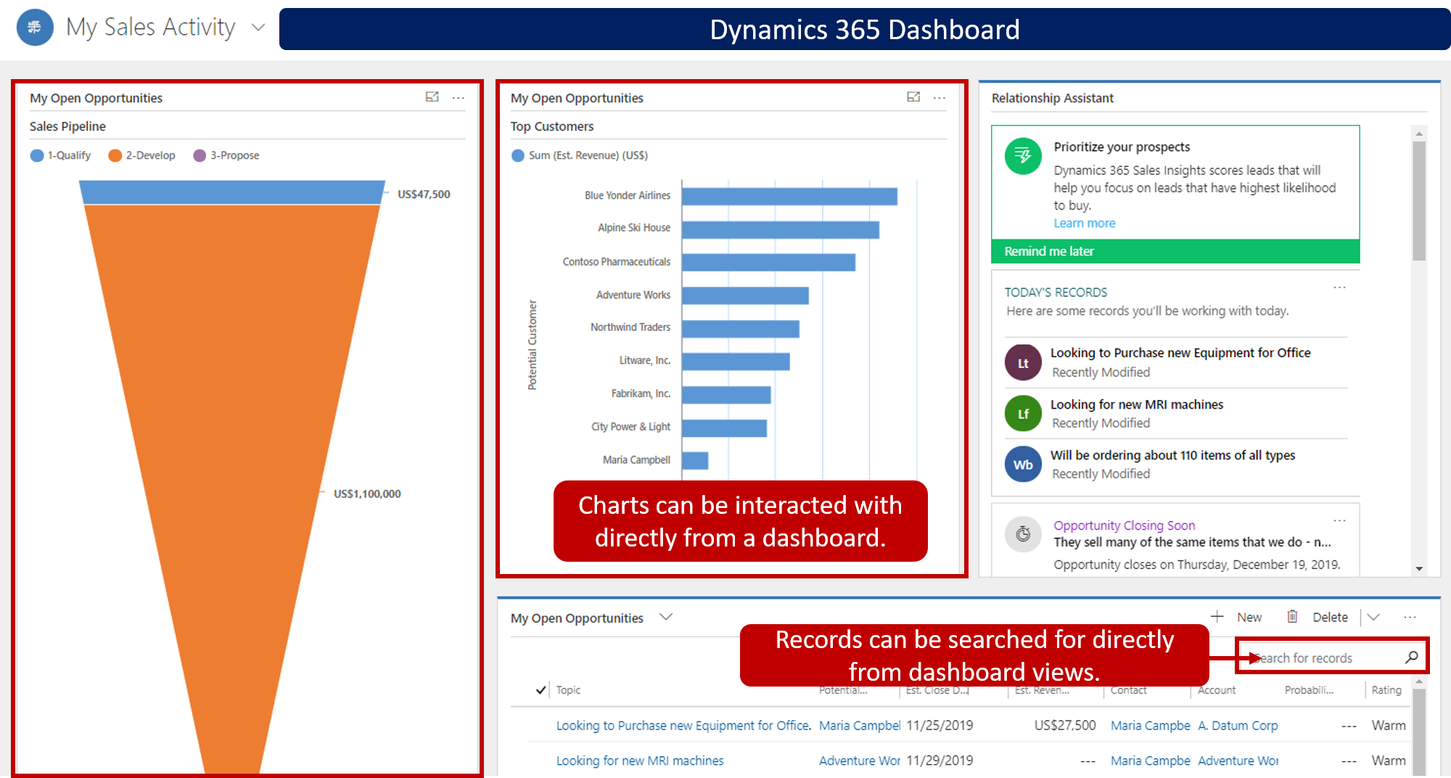
Analytical options overview

Slide 5
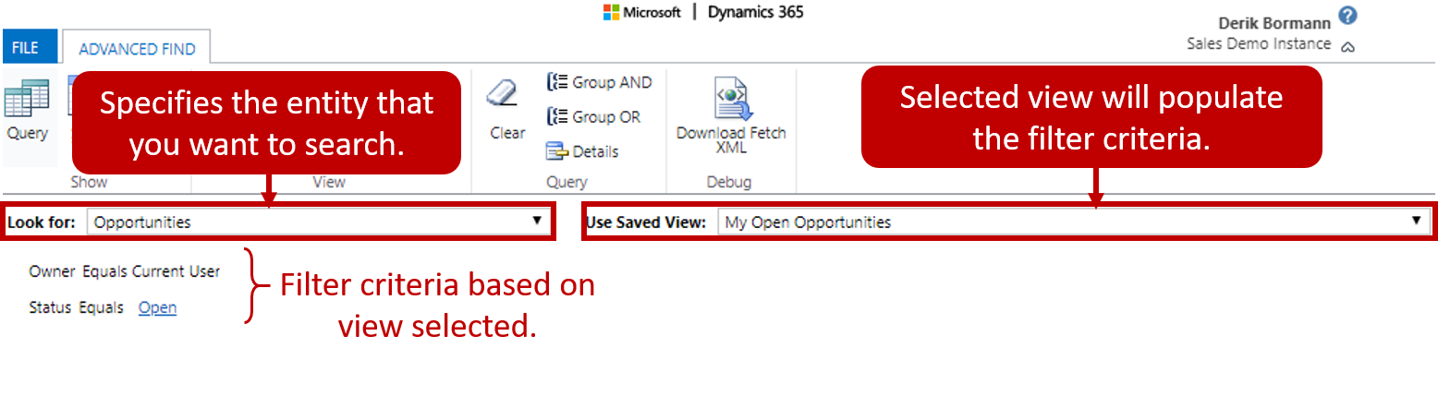
Search tools
Advanced Find
User-defined filters show desired data
Look for specifies table to search against (ex. Accounts, leads, or opportunities)
Use saved view to specify view to provide initial filter criteria

Slide 6
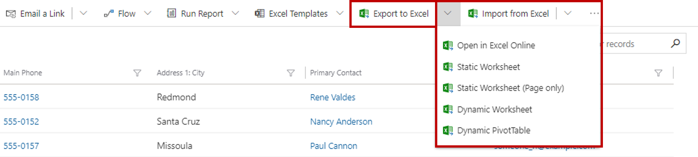
Search tools
Excel integration
Static Excel data exports: Show a snapshot of a selected view
Dynamic workbooks: Dynamically update data from the Dynamics 365 sales database
Dynamic PivotTables: Resemble dynamic workbooks, but users design PivotTable columns and rows
Microsoft Excel Online: Edit data by using Excel inside Dynamics 365

Slide 7
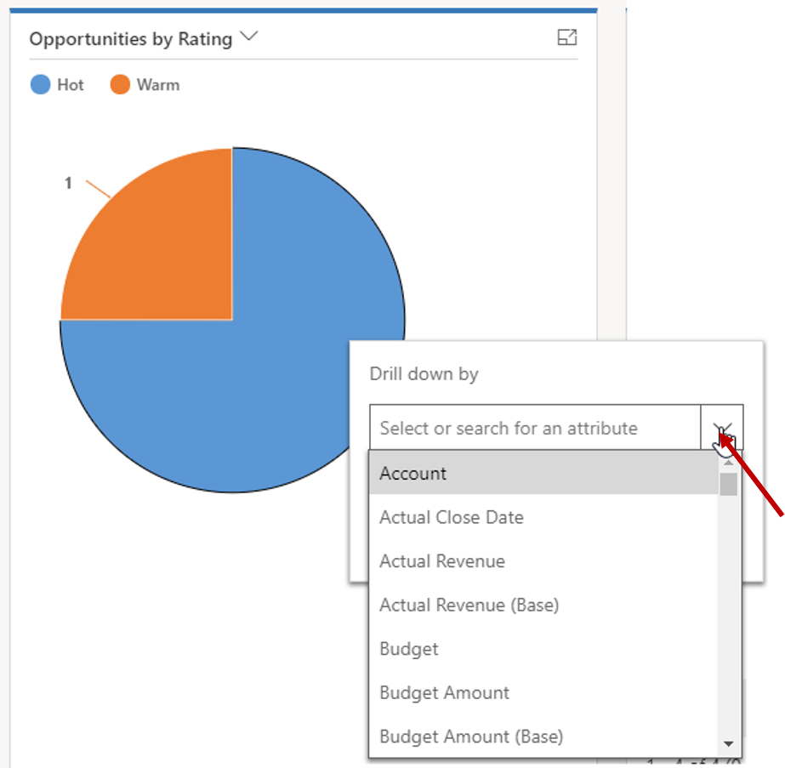
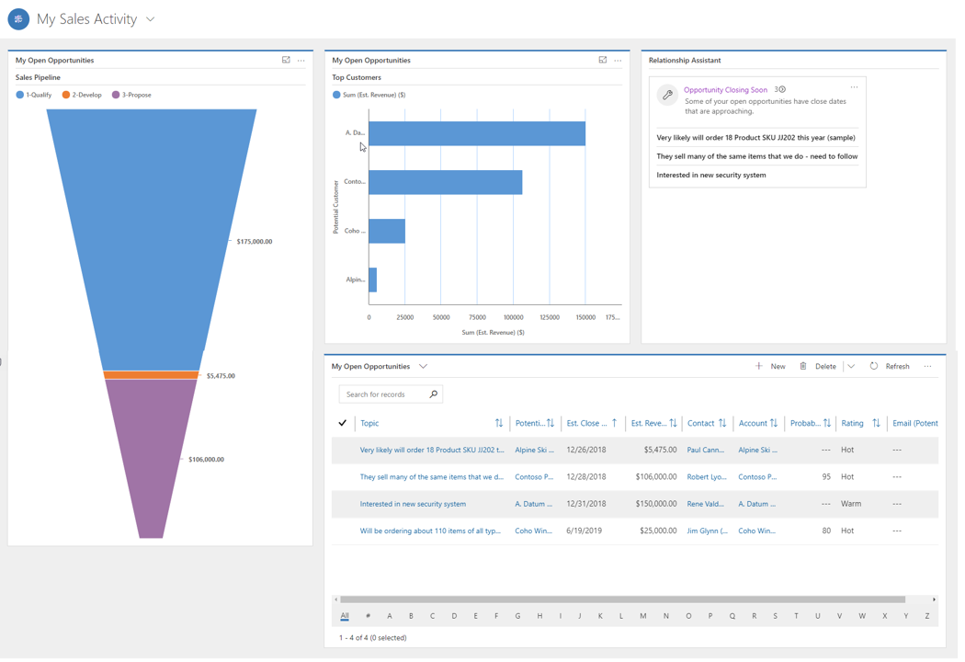
Out-of-the-box tools
Charts
Dashboards
Goals
SLAs and custom KPIs

Slide 8
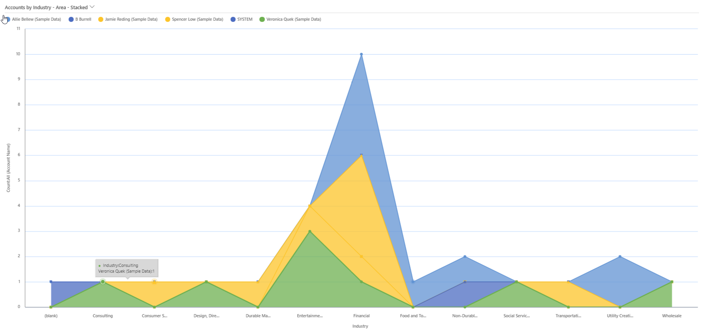
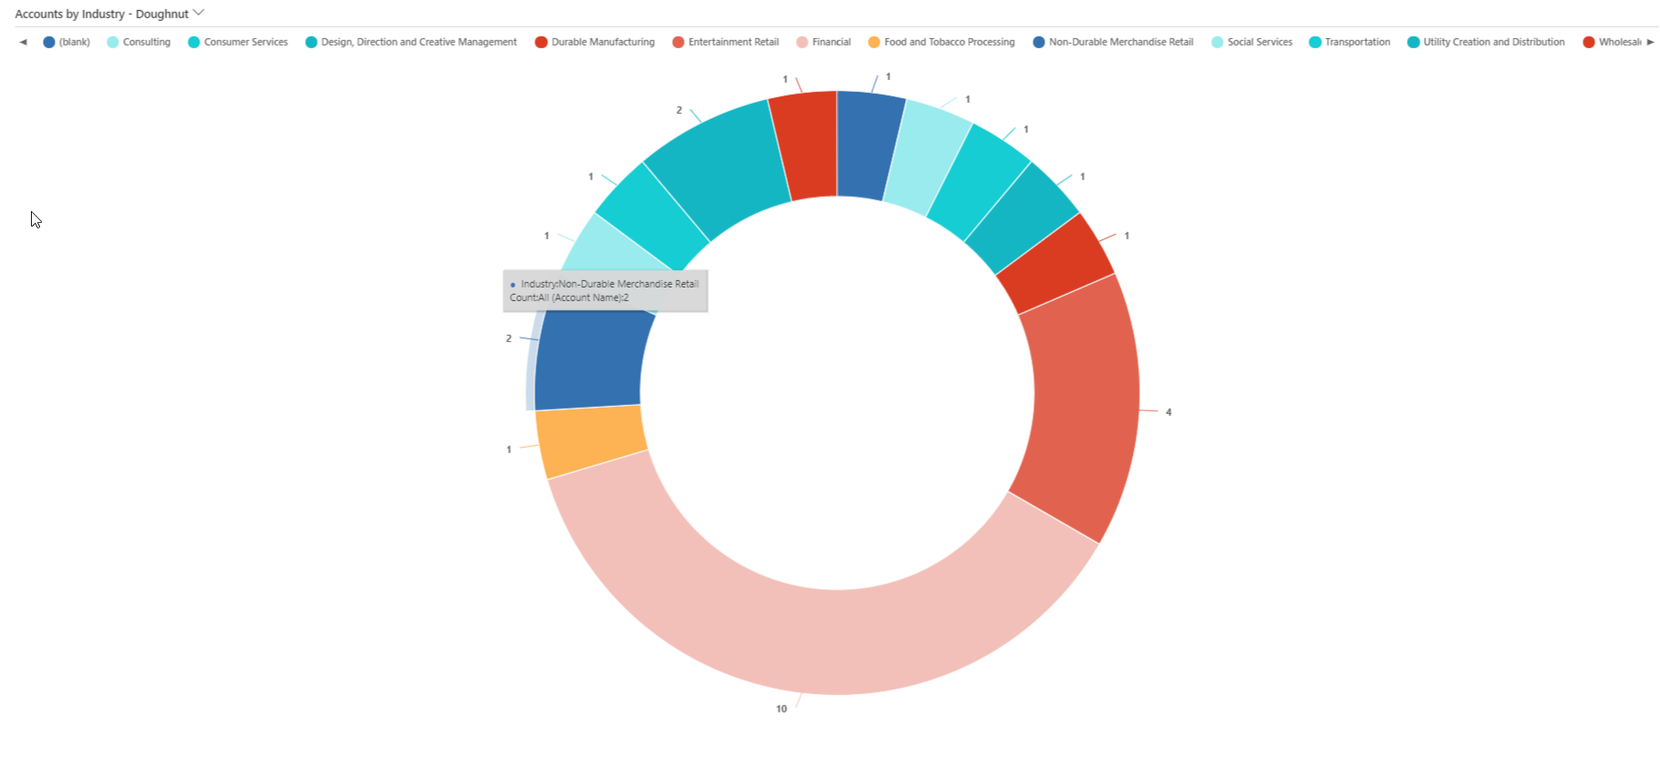
Charts
Graphical representations of data from different views of an entity
Many types of system charts available
Ability to drill down into chart
Notes:
We first look at charts as they are the building blocks to dashboards. Charts are graphical representations of data from different views of an entity. When a view is updated, so is the chart. In Dynamics 365 there are several different types of charts available. You can use the out of the box charts or you can customize your own. Once the chart is created, it can be used from within views or added to Dashboards.

Slide 9
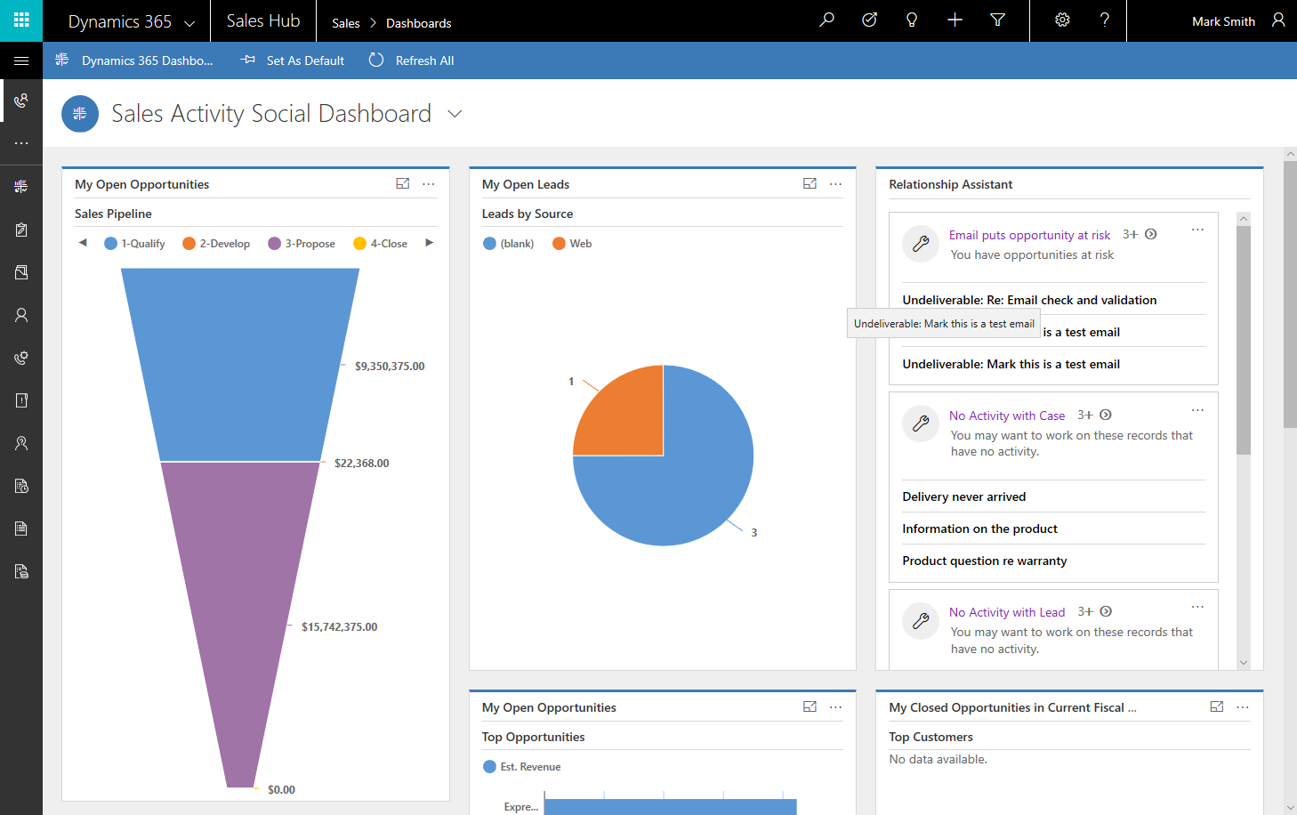
Dashboards
Collection of:
Views
Charts
iFrames
Web resources
Other types of graphical reports
Notes:
Dashboards are a collection of views, charts, IFRAMES, web resources, and several other types of graphical reports, charts or views that give you a high-level overview of data all in one location. You can show how many opportunities closed at the same time showing all the open opportunities that you still have pending.

Slide 10
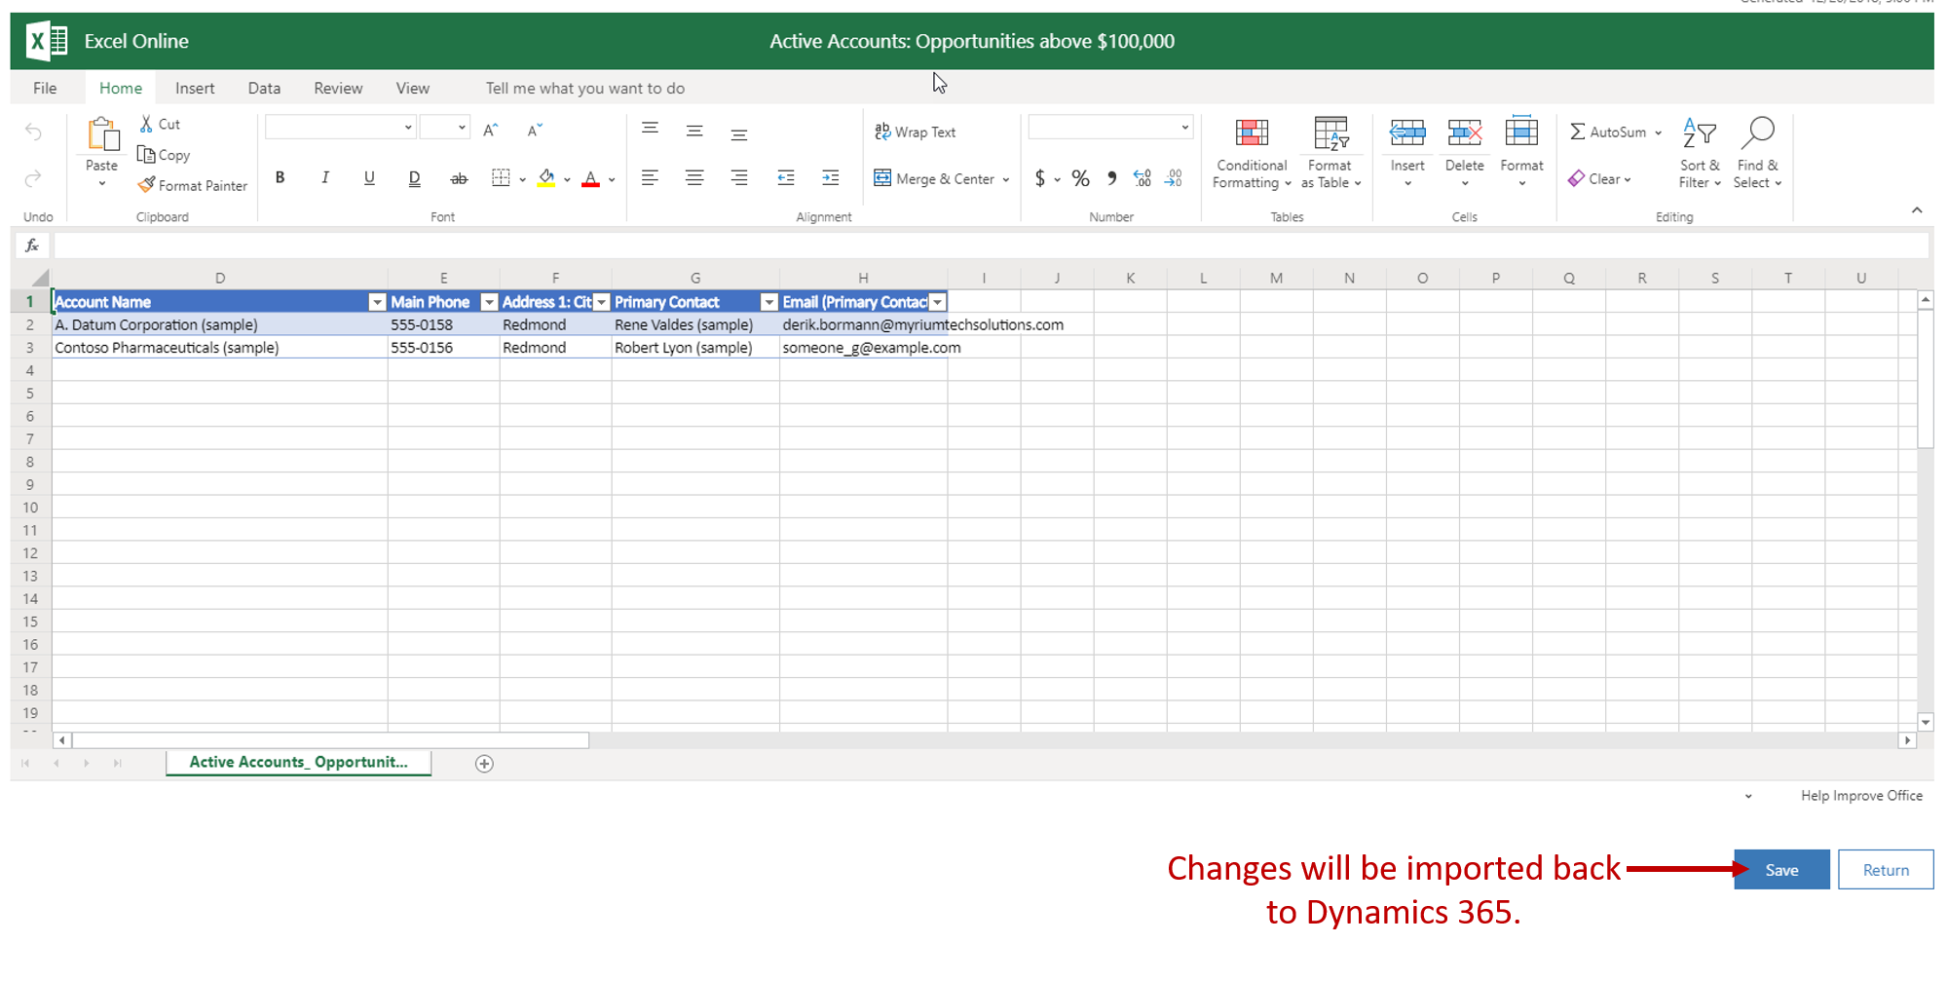
Working with inline Excel
Sometimes, you might want to do bulk edits or do quick analysis of Dynamics 365 data by using the tools that are available in Excel, but you don't need to do a full export of the data.
Notes:
Sometimes, you might want to do bulk edits or do quick analysis of Dynamics 365 data by using the tools that are available in Excel, but you don't need to do a full export of the data. Dynamics 365 lets you do quick ad-hoc analysis by using Excel Online inside Dynamics 365. For example, if you're a sales manager, you might want to analyze the opportunities that your team owns and review key performance indicators (KPIs) to see how you can help your team members. If you're a sales representative, you can open your opportunities in Excel and do what-if analysis for different incentive scenarios. Finally, you might want to quickly open the data in Excel Online so that you can copy it somewhere else, like into an email.
Any view that's currently shown in Dynamics 365 can be opened in Excel Online. Just select the Export to Excel button on the command bar, and then select Open in Excel Online on the menu that appears.
After you've finished editing your data in Excel Online, you can save the updated information back to Dynamics 365 by selecting the Save button. Remember to keep the existing format of the Excel cells, to prevent issues during import. Any additional information that you add to the workbook, like charts or colors, won't be saved.

Slide 11
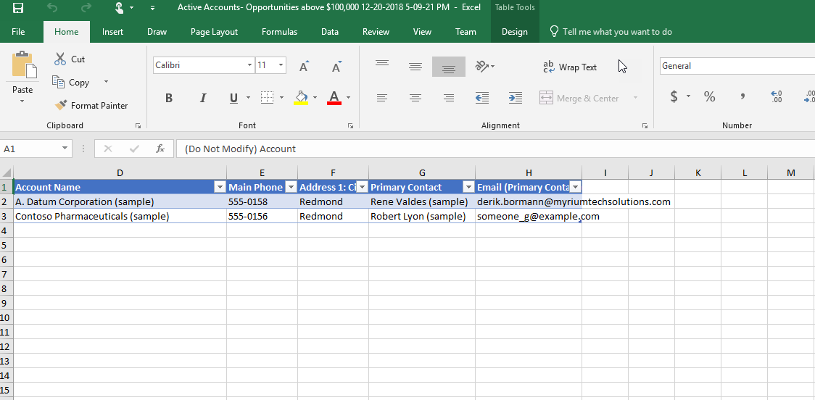
Exporting Dynamics 365 information to Excel
If you need to take advantage of the more advanced analysis tools that are available in Excel, you can export Dynamics 365 data as either static workbooks or dynamic workbooks.
Notes:
If you need to take advantage of the more advanced analysis tools that are available in Excel, you can export Dynamics 365 data as either static workbooks or dynamic workbooks. You can import both types of workbook back into Dynamics 365. If you need more advanced functions, you can export a dynamic PivotTable. PivotTables make it very easy to organize and summarize data.
The Dynamics 365 data is exported to a standard Excel file that you can then use on any device, like your phone, tablet, or desktop computer. It's exported in the same format that you see in Dynamics 365. Therefore, text remains text, numbers remain numbers, and dates remain dates. But some cell formatting might change.

Slide 12
Lesson 2: Analyze data with Power BI

Slide 13
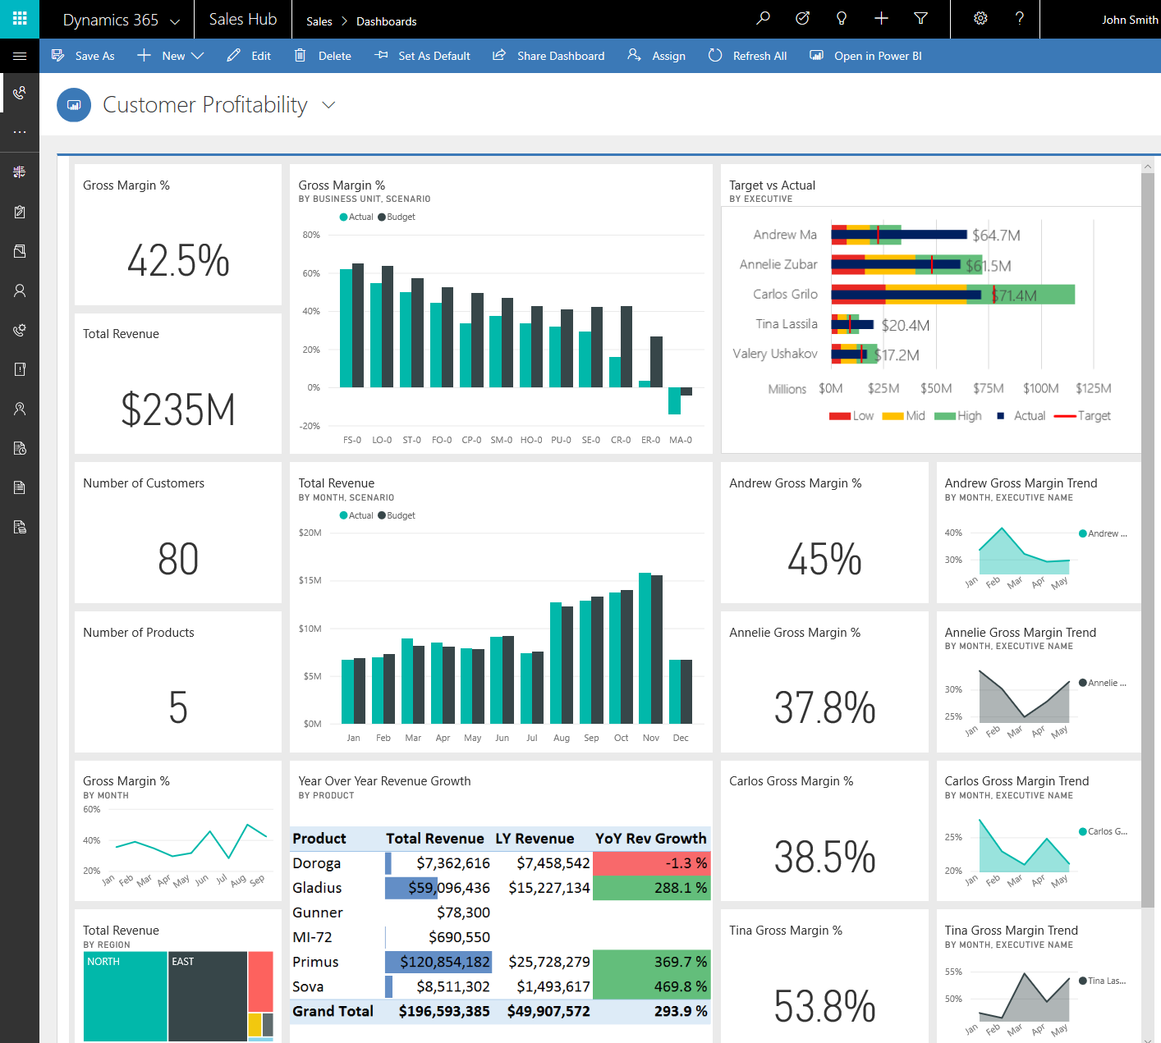
Power BI
Self-service platform to discover, analyze, and visualize data
Ability to share and collaborate insights with colleagues
Can include data sources from Dynamics 365 Sales
Notes:
A video demo is available at the following link:
You may show the video above, or you may use this demo as an example and provide students with a live demo in your personal environment. Please be aware that the video is publicly hosted on YouTube.
Power BI is a self-service platform allowing users to interact with premade reports and create their own visualizations.
A key advantage of Power BI is the ability to include many data sources as illustrated in the example above.
Salesforce, Edge (tables on the internet), Access, Excel, SQL databases and Mailchimp.
And of course, Dynamics 365
The Power BI for Office 365 cloud service works with Dynamics 365 for Sales to provide a self-service analytics solution. Power BI automatically refreshes the Dynamics 365 data displayed. With Power BI Desktop or Office Excel Power Query for authoring reports and Power BI for sharing dashboards and refreshing data from Dynamics 365. Sales personnel in your organization have a powerful way to work with Dynamics 365 for Sales data.
Power BI Dashboards can be embedded directly into Dynamics 365 for Sales.

Slide 14
Use Power BI templates
Power BI template apps are integrated packages of pre-built Power BI dashboards and reports.
Sales Analytics for Dynamics 365 Sales
Process Analytics for Dynamics 365
Notes:
Power BI template apps are integrated packages of pre-built Power BI dashboards and reports. Using Power BI template apps with Dynamics 365 Sales provides a convenient, powerful, and quick way to access and analyze your sales data.
The following Power BI template apps are now available to analyze your sales data on Dynamics 365 Sales:
Sales Analytics for Dynamics 365 Sales
Process Analytics for Dynamics 365
You can connect to and analyze your Dynamics 365 Sales data by using these Power BI template apps. You can schedule automatic data updates to ensure that you can always make the most informed and timely decisions. You can also create your own custom Power BI dashboards based on the reports in these template apps and embed them directly in Dynamics 365 Sales.

Slide 15
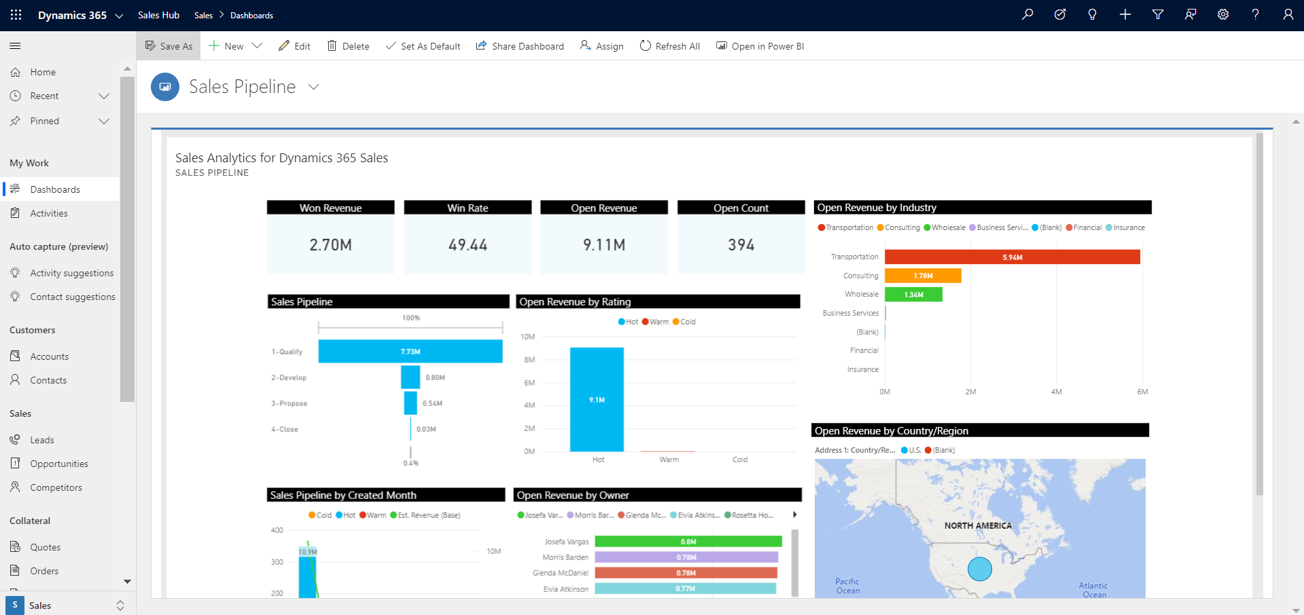
Sales Analytics for Dynamics 365 Sales
Sales managers are responsible for managing sales representatives who work with customers to close deals every day.
Monitor the sales pipeline, sales leaderboard, and top deals.
Analyze pipeline performance, won/lost deals, and lead closure.
Notes:
Sales managers are responsible for managing sales representatives who work with customers to close deals every day. Sales managers need to have visibility over key operational and pipeline metrics to drive team performance.
Managers can see trends in these metrics over a period of time to understand how sellers are performing, so that they can take corrective measures, provide appropriate guidance to sellers, and improve the customer purchase experience.
As a sales manager, use this dashboard to perform the following tasks:
Monitor the sales pipeline, sales leaderboard, and top deals.
Analyze pipeline performance, won/lost deals, and lead closure.
[!div class="mx-imgBorder"] Screenshot of the Sales analytics dashboard.

Slide 16
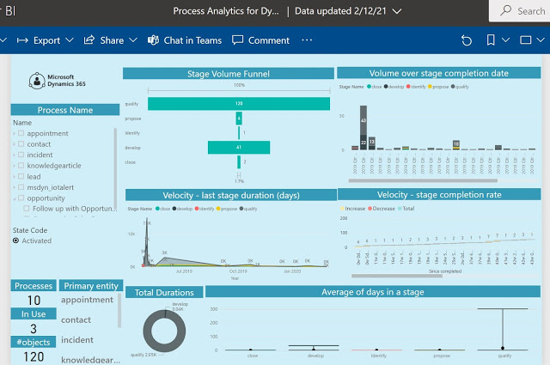
Process Analytics for Dynamics 365
The Process Analytics for Dynamics 365 Power BI template app is designed to help sales enablement managers get insights into the performance of their business process flows.
Track business process performance.
Create custom dashboards that focus on just one business process.
Notes:
The Process Analytics for Dynamics 365 Power BI template app is designed to help sales enablement managers get insights into the performance of their business process flows.
Sales enablement managers can track key performance indicators, including the velocity of records through process stages to understand how efficient their organizational processes are, and fine-tune process definitions to achieve maximum efficiency.
As a sales enablement manager, use this template app to perform the following tasks:
Track business process performance.
Create custom dashboards that focus on just one business process.
[!div class="mx-imgBorder"] Screenshot of the Process analytics dashboard.
For more information, visit Configure Power BI template apps to work with Dynamics 365 Sales or Customize Power BI template apps for Dynamics 365 Sales.

Slide 17
Closing slide

